Slide 1
SECURE DATA HIDING IN IMAGES USING STENOGRAPHY
CAPSTONE PROJECT
Presented By:D.SUMANASREE
Student Name : D.SUMANASREE
College Name & Department : JNTU Anantapur,ECE

Slide 2
OUTLINE
Problem Statement
Technology used
Wow factor
End users
Result
Conclusion
Git-hub Link
Future scope

Slide 3
Problem Statement
The problem being addressed is the need for secure communication, particularly in environments where confidentiality is critical. Traditional methods of data transmission may expose sensitive information to unauthorized access. The project aims to implement a secure data hiding technique where a secret message can be embedded in an image, making it undetectable to the naked eye. The image is used as a carrier to embed the message, and only those with the correct passcode can decrypt it, providing an additional layer of security.

Slide 4
Technology used
OpenCV: OpenCV (Open Source Computer Vision Library) is used to process the image and manipulate pixel values to hide and retrieve the secret message. This library helps in reading, writing, and modifying the image.
Python: The programming language used for implementing the logic and user interface. It is efficient and easy to work with when implementing encryption, steganography, and image processing.
Steganography: This technique involves hiding data within other data, specifically in an image in this case. The code manipulates pixel values in the image to encode a secret message, making it undetectable without the correct key (password).
Encryption and Decryption: Basic encryption and decryption techniques are used in combination with the passcode to ensure that only authorized users can retrieve the hidden message.
Visual Studio: This platform is used to run and visualize the code to get results.

Slide 5
Wow factors
Invisibility: The hidden message is concealed within the image in such a way that it's virtually impossible to detect with the naked eye, making the data-stealing process difficult.
Password Protection: Adding an extra layer of security through a password to unlock the hidden message ensures only authorized users can decrypt the information, further protecting the data from unauthorized access.
Simple and Effective: The use of simple techniques (e.g., altering pixel values) combined with password protection creates an accessible and efficient solution for secure data hiding.
Real-time Execution: The image gets modified dynamically as the user inputs the secret message, with the result being immediately visible. Users can interact with the code to both hide and retrieve the information.
Cross-Platform: The code can run across different operating systems (Windows, Linux, MacOS), providing flexibility in usage. It supports both reading and saving of images.

Slide 6
End users
Individuals: Anyone who needs to share sensitive or personal information securely, such as a private message, without risk of it being intercepted.
Corporations: Organizations that need to share confidential information across insecure channels can use this method to hide messages in images and ensure that only authorized personnel can decrypt it.
Government Agencies: Agencies needing secure communication for operational purposes, where confidentiality is essential.
Researchers: Scholars in the field of cybersecurity or data protection who are interested in implementing or learning about steganography techniques.

Slide 7
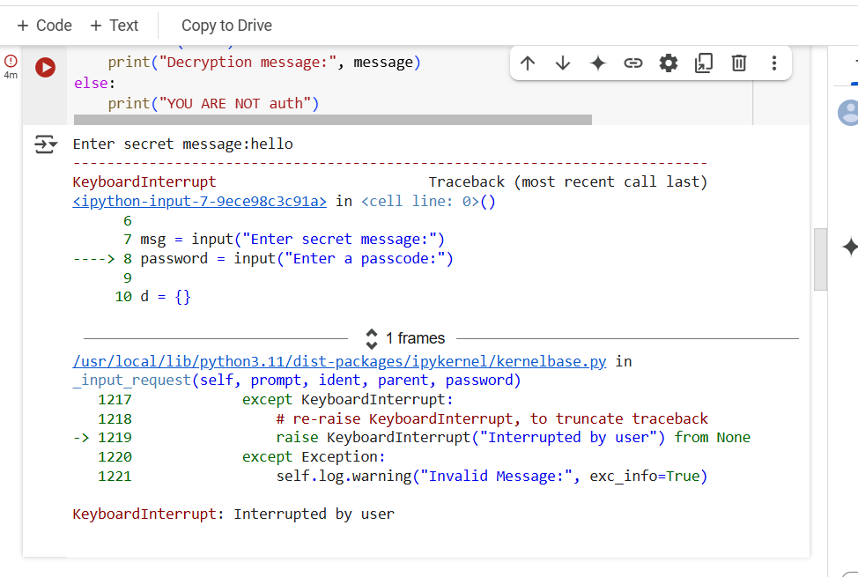
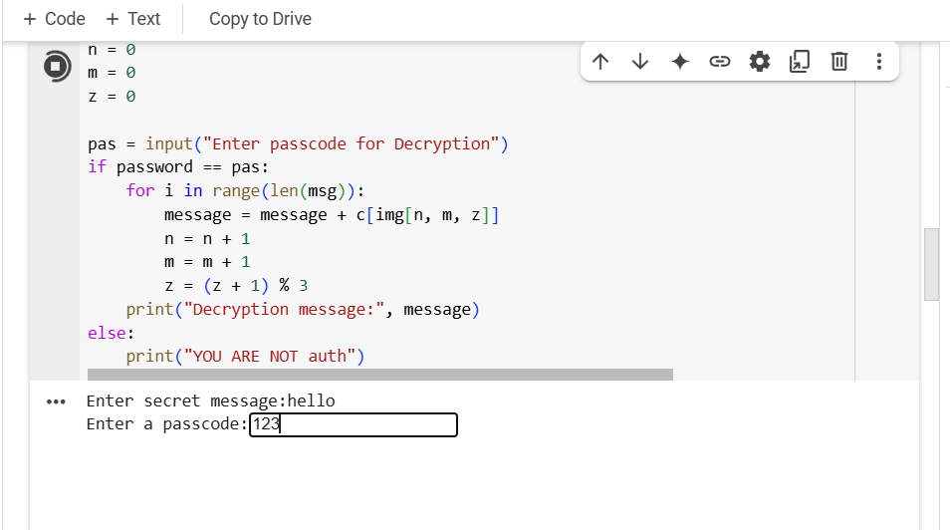
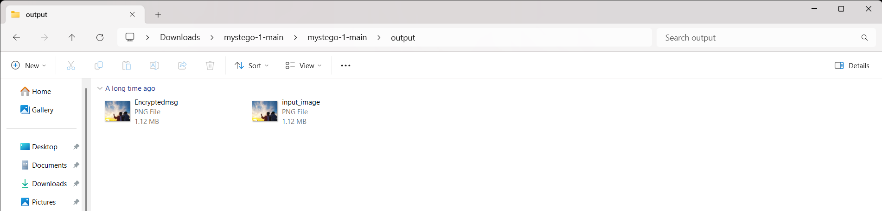
Results

Slide 8
Conclusion
This project successfully demonstrates how steganography can be used to securely hide messages within images, ensuring privacy during communication. By modifying the least significant bits of an image, the secret message is embedded in such a way that it's undetectable to the naked eye. The added layer of password protection further enhances security, making sure only authorized users can decrypt the message. This technique is simple yet effective for applications in secure data transmission, with the potential for further improvements and enhancements to increase its robustness.

Slide 9
GitHub Link
https://github.com/Sumanarayudu/csproject.git

Slide 10
THANK YOU

